Slide 1
UNIT-2
CPU SCHEDULING

Slide 2
What is CPU Scheduling?
CPU Scheduling is a process of determining which process will own CPU for execution while another process is on hold. The main task of CPU scheduling is to make sure that whenever the CPU remains idle, the OS at least select one of the processes available in the ready queue for execution. The selection process will be carried out by the CPU scheduler. It selects one of the processes in memory that are ready for execution.

Slide 3
Need of Scheduling
In the uniprogrammming systems like MS DOS, when a process waits for any I/O operation to be done, the CPU remains idol. This is an overhead since it wastes the time and causes the problem of starvation. However, In Multiprogramming systems, the CPU doesn't remain idle during the waiting time of the Process and it starts executing other processes. Operating System has to define which process the CPU will be given.
In Multiprogramming systems, the Operating system schedules the processes on the CPU to have the maximum utilization of it and this procedure is called CPU scheduling. The Operating System uses various scheduling algorithm to schedule the processes.

Slide 4
Preemptive Scheduling
In Preemptive Scheduling, the tasks are mostly assigned with their priorities. Sometimes it is important to run a task with a higher priority before another lower priority task, even if the lower priority task is still running. The lower priority task holds for some time and resumes when the higher priority task finishes its execution.

Slide 5
Non-Preemptive Scheduling
In this type of scheduling method, the CPU has been allocated to a specific process. The process that keeps the CPU busy will release the CPU either by switching context or terminating. It is the only method that can be used for various hardware platforms. That’s because it doesn’t need special hardware (for example, a timer) like preemptive scheduling.

Slide 6
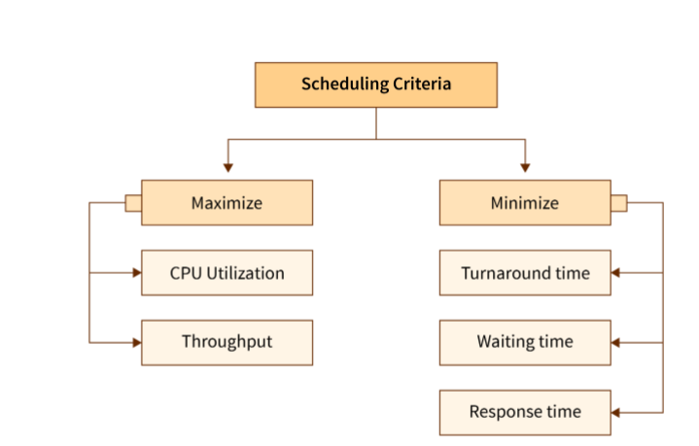
CPU SCHEDULING CRITERIA

Slide 7
What is Dispatcher/Short term scheduler?
It is a module that provides control of the CPU to the process. The Dispatcher should be fast so that it can run on every context switch. Dispatch latency is the amount of time needed by the CPU scheduler to stop one process and start another.
Functions performed by Dispatcher:
Context Switching
Switching to user mode
Moving to the correct location in the newly loaded program.

Slide 8
Types of Schedulers
Long Term Scheduler
It brings the new process to the ‘Ready State’. It controls the Degree of Multi-programming, i.e., the number of processes present in a ready state at any point in time. It is important that the long-term scheduler make a careful selection of both I/O and CPU-bound processes. I/O-bound tasks are which use much of their time in input and output operations while CPU-bound processes are which spend their time on the CPU. The job scheduler increases efficiency by maintaining a balance between the two. They operate at a high level and are typically used in batch-processing systems.

Slide 9
Short-term or CPU scheduler:
It is responsible for selecting one process from the ready state for scheduling it on the running state. Note: Short-term scheduler only selects the process to schedule it doesn’t load the process on running. Here is when all the scheduling algorithms are used. The CPU scheduler is responsible for ensuring there is no starvation owing to high burst time processes.

Slide 10
Medium-term scheduler:
It is responsible for suspending and resuming the process. It mainly does swapping (moving processes from main memory to disk and vice versa). Swapping may be necessary to improve the process mix or because a change in memory requirements has overcommitted available memory, requiring memory to be freed up. It is helpful in maintaining a perfect balance between the I/O bound and the CPU bound. It reduces the degree of multiprogramming.

Slide 11
FIRST COME FIRST SERVE
First come first serve (FCFS) scheduling algorithm simply schedules the jobs according to their arrival time. The job which comes first in the ready queue will get the CPU first. The lesser the arrival time of the job, the sooner will the job get the CPU. FCFS scheduling may cause the problem of starvation if the burst time of the first process is the longest among all the jobs.

Slide 12
Advantages of FCFS
Simple
Easy
First come, First serve
Disadvantages of FCFS
Due to the non-preemptive nature of the algorithm, the problem of starvation may occur.
Although it is easy to implement, but it is poor in performance since the average waiting time is higher as compare to other scheduling algorithms.

Slide 13
FIRST COME FIRST SERVE –EXAMPLE 1
Processes | Arrival Time | Burst Time
P1 | 0 | 4
P2 | 1 | 3
P3 | 2 | 1
P4 | 3 | 2
P5 | 4 | 5

Slide 14


Slide 15
FCFS-EXAMPLE 2
Process Id | Arrival time | Burst time
P1 | 3 | 4
P2 | 5 | 3
P3 | 0 | 2
P4 | 5 | 1
P5 | 4 | 3

Slide 16
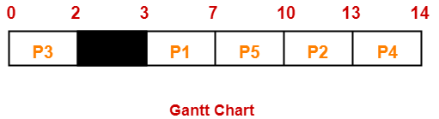
FCFS-EXAMPLE2

Slide 17
CONVOY EFFECT
FCFS algorithm is non-preemptive in nature, that is, once CPU time has been allocated to a process, other processes can get CPU time only after the current process has finished. This property of FCFS scheduling leads to the situation called Convoy Effect

Slide 18
CONVOY EFFECT
Process ID | Arrival Time | Burst Time | Completion Time | Turn Around Time | Waiting Time
P1 | 0 | 50 | 50 | 50 | 0
P2 | 1 | 1 | 51 | 50 | 49
P3 | 1 | 2 | 53 | 52 | 50

Slide 19
CONVOY EFFECT
Here in this example, Process P1 will keep on executing until it finishes its execution time, so that other smaller processes that are P2 and P3 will have to wait for P1 termination. In this state, P2 and P3 will have to starve for a very long duration. This leads to convoy effect.

Slide 20
SHORTEST JOB FIRST
Shortest Job First (SJF) is an algorithm in which the process having the smallest execution time is chosen for the next execution. This scheduling method can be preemptive or non-preemptive. It significantly reduces the average waiting time for other processes awaiting execution. The full form of SJF is Shortest Job First

Slide 21
SJF –SHORTEST JOB FIRST
Advantages of SJF
Maximum throughput
Minimum average waiting and turnaround time
Disadvantages of SJF
May suffer with the problem of starvation
It is not implementable because the exact Burst time for a process can't be known in advance.

Slide 22
SJF WITH NON-PREEMPTION
Process Id | Arrival time | Burst time
P1 | 3 | 1
P2 | 1 | 4
P3 | 4 | 2
P4 | 0 | 6
P5 | 2 | 3

Slide 23
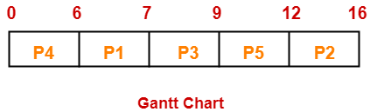
SJF-NON PREEMPTION

Slide 24
SJF-NON PREEMPTION
PROCESSES | AT | BT | CT | TAT | BT
P1 | 3 | 1 | 7 | 4 | 3
P2 | 1 | 4 | 16 | 15 | 11
P3 | 4 | 2 | 9 | 5 | 3
P4 | 0 | 6 | 6 | 6 | 0
P5 | 2 | 3 | 12 | 10 | 7

Slide 25
EXAMPLE2 –SJF WITH NON-PREEMPTION
PROCESS | AT | BT
P1 | 2 | 1
P2 | 1 | 5
P3 | 4 | 1
P4 | 0 | 6
P5 | 2 | 3

Slide 26
SJF-NON PREEMPTION
Here in this at 0 time, only P4 has arrived so we have to execute P4 as this is non preemptive scheduling so it will get executed completely.
Now we have to check any other process has arrived between 0-6, P1,P2,P3,P5 all will come to the ready queue.
So now we have to check depending upon their shortest times. Now from p1 and p3 is having same burst times, so now apply fcfs and allocate cpu to p1.
Now in ready queue p2,p3,p5 will come, and p3 is minimum, we will pick p3.
Now from p5 and p2, p5 is having shortest time, so we will pick p5. Then finally we will execute p2

Slide 27
SJF-NON PREEMPTION
process | AT | BT | CT | TAT | WT | RT
P1 | 2 | 1 | 7 | 5 | 4 | 6-2=4
P2 | 1 | 5 | 16 | 15 | 10 | 11-1=10
P3 | 4 | 1 | 8 | 4 | 3 | 7-4=3
P4 | 0 | 6 | 6 | 6 | 0 | 0-0=0
P5 | 2 | 3 | 11 | 9 | 6 | 8-2=6S

Slide 28
SHORTEST REMAINING TIME FIRST/SJF WITH PREEMPTION
This Algorithm is the preemptive version of SJF scheduling. In SRTF, the execution of the process can be stopped after certain amount of time. At the arrival of every process, the short term scheduler schedules the process with the least remaining burst time among the list of available processes and the running process.
Once all the processes are available in the ready queue, No preemption will be done and the algorithm will work as SJF scheduling. The context of the process is saved in the Process Control Block when the process is removed from the execution and the next process is scheduled. This PCB is accessed on the next execution of this process.

Slide 29
Process | Burst Time | Arrival Time
P1 | 6 ms | 2 ms
P2 | 2 ms | 5 ms
P3 | 8 ms | 1 ms
P4 | 3 ms | 0 ms
P5 | 4 ms | 4 ms

Slide 30

SJF WITH PREEMPTION

Slide 31
EXAMPLE 2- SJF WITH PREEMPTION/SRTF
Process ID | Arrival Time | Burst Time
1 | 0 | 8
2 | 1 | 4
3 | 2 | 2
4 | 3 | 1
5 | 4 | 3
6 | 5 | 2

Slide 32
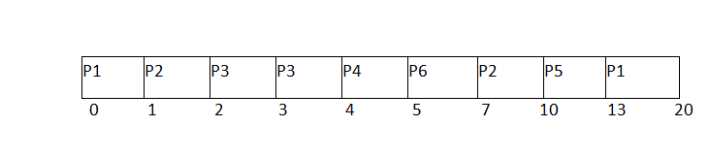
SRTF/SJF WITH PREEMPTION-GANTT CHART

Slide 33
SJF WITH PREEMPTION-CONTINUED
Process ID | Arrival Time | Burst Time | Completion Time | Turn Around Time | Waiting Time
1 | 0 | 8 | 20 | 20 | 12
2 | 1 | 4 | 10 | 9 | 5
3 | 2 | 2 | 4 | 2 | 0
4 | 3 | 1 | 5 | 2 | 1
5 | 4 | 3 | 13 | 9 | 6
6 | 5 | 2 | 7 | 2 | 0

Slide 34
ROUND ROBIN SCHEDULING
Round robin is a pre-emptive algorithm
The CPU is shifted to the next process after fixed interval time, which is called time quantum/time slice.
The process that is preempted is added to the end of the queue.
Round robin is a hybrid model which is clock-driven
Time slice should be minimum, which is assigned for a specific task that needs to be processed. However, it may differ OS to OS.
It is a real time algorithm which responds to the event within a specific time limit.
Round robin is one of the oldest, fairest, and easiest algorithm.
Widely used scheduling method in traditional OS.

Slide 35
ROUND ROBIN EXAMPLE
Process ID | Arrival Time | Burst Time
1 | 0 | 5
2 | 1 | 6
3 | 2 | 3
4 | 3 | 1
5 | 4 | 5
6 | 6 | 4

Slide 36
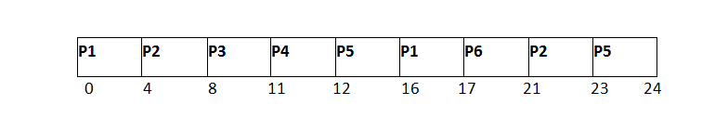
ROUND ROBIN EXAMPLE-GANTT CHART

Slide 37
ROUND ROBIN EXAMPLE CONTINUED-FIND THE AVERAGE WAITING TIME, AVERAGE TURNAROUND TIME AND RESPONSE TIME
Process ID | Arrival Time | Burst Time | Completion Time | Turn Around Time | Waiting Time
1 | 0 | 5 | 17 | 17 | 12
2 | 1 | 6 | 23 | 22 | 16
3 | 2 | 3 | 11 | 9 | 6
4 | 3 | 1 | 12 | 9 | 8
5 | 4 | 5 | 24 | 20 | 15
6 | 6 | 4 | 21 | 15 | 11

Slide 38
EXAMPLE2- ROUND ROBIN
Process Id | Arrival time | Burst time
P1 | 0 | 4
P2 | 1 | 5
P3 | 2 | 2
P4 | 3 | 1
P5 | 4 | 6
P6 | 6 | 3

Slide 39
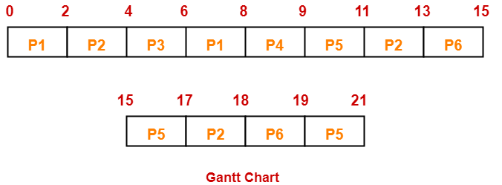
ROUND ROBIN SCHEDULING CONTINUED

Slide 40
ROUND ROBIN EXAMPLE 2 CONTINUED
Process Id | CT | Turn Around time | Waiting time
P1 | 8 | 8 – 0 = 8 | 8 – 4 = 4
P2 | 18 | 18 – 1 = 17 | 17 – 5 = 12
P3 | 6 | 6 – 2 = 4 | 4 – 2 = 2
P4 | 9 | 9 – 3 = 6 | 6 – 1 = 5
P5 | 21 | 21 – 4 = 17 | 17 – 6 = 11
P6 | 19 | 19 – 6 = 13 | 13 – 3 = 10

Slide 41
PRIORITY SCHEDULING
Preemptive Scheduling
In Preemptive Scheduling, the tasks are mostly assigned with their priorities. Sometimes it is important to run a task with a higher priority before another lower priority task, even if the lower priority task is still running. The lower priority task holds for some time and resumes when the higher priority task finishes its execution.
Non-Preemptive Scheduling
In this type of scheduling method, the CPU has been allocated to a specific process. The process that keeps the CPU busy, will release the CPU either by switching context or terminating. It is the only method that can be used for various hardware platforms. That’s because it doesn’t need special hardware (for example, a timer) like preemptive scheduling.

Slide 42
NON PREEMPTIVE PRIORITY SCHEDULING EXAMPLE
Process ID | Priority | Arrival Time | Burst Time
1 | 2 | 0 | 3
2 | 6 | 2 | 5
3 | 3 | 1 | 4
4 | 5 | 4 | 2
5 | 7 | 6 | 9
6 | 4 | 5 | 4
7 | 10 | 7 | 10

Slide 43
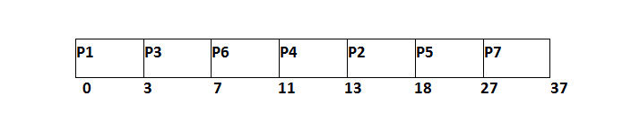
NON PREEMPTIVE PRIORITY SCHEDULING EXAMPLE

Slide 44
NON PREEMPTIVE PRIORITY SCHEDULING EXAMPLE
Process Id | Priority | Arrival Time | Burst Time | Completion Time | Turnaround Time | Waiting Time | Response Time
1 | 2 | 0 | 3 | 3 | 3 | 0 | 0
2 | 6 | 2 | 5 | 18 | 16 | 11 | 11
3 | 3 | 1 | 4 | 7 | 6 | 2 | 2
4 | 5 | 4 | 2 | 13 | 9 | 7 | 7
5 | 7 | 6 | 9 | 27 | 21 | 12 | 12
6 | 4 | 5 | 4 | 11 | 6 | 2 | 2
7 | 10 | 7 | 10 | 37 | 30 | 20 | 20

Slide 45
PREEMPTIVE-PRIORITY SCHEDULING- CONSIDER SMALLER NUMBER MEANS HIGH PRIORITY
Process Id | Priority | Arrival Time | Burst Time
1 | 2(L) | 0 | 1
2 | 6 | 1 | 7
3 | 3 | 2 | 3
4 | 5 | 3 | 6
5 | 4 | 4 | 5
6 | 10(H) | 5 | 15
7 | 9 | 15 | 8

Slide 46
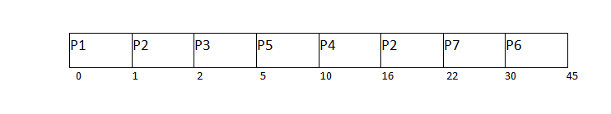
PREEMPTIVE-PRIORITY SCHEDULING- FIND OUT AVERAGE WT, TAT, AND COMPLETION TIME

Slide 47
MULTILEVEL QUEUE SCHEDULING
It may happen that processes in the ready queue can be divided into different classes where each class has its own scheduling needs.
For example, a common division is a foreground (interactive) process and a background (batch) process. These two classes have different scheduling needs. For this kind of situation Multilevel Queue Scheduling is used.

Slide 48
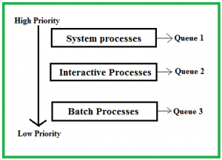
Ready Queue is divided into separate queues for each class of processes. For example, let us take three different types of processes System processes, Interactive processes, and Batch Processes. All three processes have their own queue. Now, look at the below figure.

Slide 49
All three different type of processes has their own queue. Each queue has its own Scheduling algorithm. For example, queue 1 and queue 2 uses Round Robin while queue 3 can use FCFS to schedule their processes.

Slide 50
Question?
Scheduling among the queues: What will happen if all the queues have some processes? Which process should get the CPU? To determine this Scheduling among the queues is necessary. There are two ways to do so –

Slide 51
Fixed priority preemptive scheduling method – Each queue has absolute priority over the lower priority queue. Let us consider following priority order queue 1 > queue 2 > queue 3.According to this algorithm, no process in the batch queue(queue 3) can run unless queues 1 and 2 are empty. If any batch process (queue 3) is running and any system (queue 1) or Interactive process(queue 2) entered the ready queue the batch process is preempted.
Time slicing – In this method, each queue gets a certain portion of CPU time and can use it to schedule its own processes. For instance, queue 1 takes 50 percent of CPU time queue 2 takes 30 percent and queue 3 gets 20 percent of CPU time.

Slide 52
Priority of Q1 is greater than Q2, the Q1 follows round robin with time quantum of 2 and Q2 follows first come first serve
PROCESS | ARRIVAL TIME | CPU BURST TIME | QUEUE NUMBER
P1 | 0 | 4 | 1
P2 | 0 | 3 | 1
P3 | 0 | 8 | 2
P4 | 10 | 5 | 1

Slide 53


Slide 54
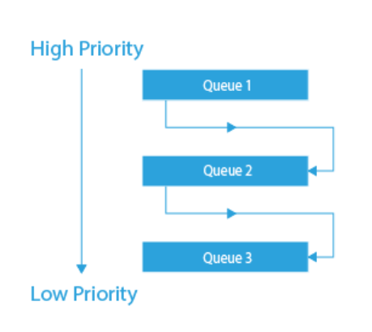
MULTILEVEL FEEDBACK QUEUE
Multilevel Feedback Queue scheduling:

Slide 55
MULTILEVEL FEEDBACK QUEUE
In multilevel feedback scheduling, the processes are allowed to move in between the queues, the idea behind is to separate the processes with different CPU – burst characteristics. If any process uses too much CPU then it’ll be moved to the lower priority queue and if a process waiting too much for the CPU is moved to the high priority queue this prevents starvation. Multilevel feedback queue is the most general scheme and also the most complex.

Slide 56
MULTILEVEL FEEDBACK QUEUE
Advantages of MLFQ:
MLFQ allows different processes to move between different queues.
It prevents starvation.
MLFQ is more flexible.

Slide 57
Multiple-Processor Scheduling in Operating System
In multiple-processor scheduling multiple CPU’s are available and hence Load Sharing becomes possible. However multiple processor scheduling is more complex as compared to single processor scheduling.

Slide 58
Approaches to Multiple-Processor Scheduling –
One approach is when all the scheduling decisions and I/O processing are handled by a single processor which is called the Master Server and the other processors executes only the user code. This is simple and reduces the need of data sharing. This entire scenario is called Asymmetric Multiprocessing.

Slide 59
A second approach uses Symmetric Multiprocessing where each processor is self scheduling. All processes may be in a common ready queue or each processor may have its own private queue for ready processes. The scheduling proceeds further by having the scheduler for each processor examine the ready queue and select a process to execute.

Slide 60
PROCESS AFFINITY
When a process runs on a specific processor there are certain effects on the cache memory.
Now if the process migrates to another processor, the contents of the cache memory must be invalidated for the first processor and the cache for the second processor must be repopulated.
Because of the high cost of invalidating and repopulating caches, most of the SMP(symmetric multiprocessing) systems try to avoid migration of processes from one processor to another and try to keep a process running on the same processor. This is known as PROCESSOR AFFINITY.

Slide 61
Types of Processor Affinity
There are two types of processor affinity:
Soft Affinity – When an operating system has a policy of attempting to keep a process running on the same processor but not guaranteeing it will do so, this situation is called soft affinity.
Hard Affinity – Hard Affinity allows a process to specify a subset of processors on which it may run.

Slide 62
Load Balancing –
Load Balancing is the phenomena which keeps the workload evenly distributed across all processors in an SMP system.
Load balancing is unnecessary because once a processor becomes idle it immediately extracts a runnable process from the common run queue.
On SMP(symmetric multiprocessing), it is important to keep the workload balanced among all processors to fully utilize the benefits of having more than one processor else one or more processor will sit idle while other processors have high workloads along with lists of processors awaiting the CPU.

Slide 63
Load balancing ways
Push Migration – In push migration a task routinely checks the load on each processor and if it finds an imbalance then it evenly distributes load on each processors by moving the processes from overloaded to idle or less busy processors.
Pull Migration – Pull Migration occurs when an idle processor pulls a waiting task from a busy processor for its execution.

Slide 64
ASYMMETRIC
Master-Slave Multiprocessor
In this multiprocessor model, there is a single data structure that keeps track of the ready processes. In this model, one central processing unit works as a master and another as a slave. All the processors are handled by a single processor, which is called the master server.

Slide 65
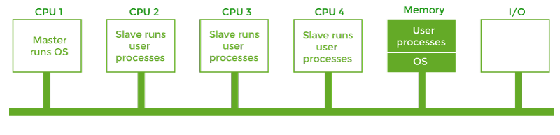
ASYMMETRIC MULTIPROCESSING

Slide 66
ASYMMETRIC MULTIPROCESSING
The master server runs the operating system process, and the slave server runs the user processes. The memory and input-output devices are shared among all the processors, and all the processors are connected to a common bus. This system is simple and reduces data sharing, so this system is called Asymmetric multiprocessing.

Slide 67
Symmetric Multiprocessor
There is one copy of the OS in memory in this model, but any central processing unit can run it. Now, when a system call is made, the central processing unit on which the system call was made traps the kernel and processed that system call. This model balances processes and memory dynamically. This approach uses Symmetric Multiprocessing, where each processor is self-scheduling.
The scheduling proceeds further by having the scheduler for each processor examine the ready queue and select a process to execute. In this system, this is possible that all the process may be in a common ready queue or each processor may have its private queue for the ready process.

Slide 68
THANK YOU

